Slide 1
Theories of Failure
Presented By-
Vineet Kumar Vashishtha
Asst. Professor
KIET Group of Institutions
Team ID: 1012_005

Slide 2
Theories of Failure
When an engineer is select a material for the design purpose, it becomes important to calculate the state of stress that defines the material's failure. So finding the state of stress it is necessary to find the acceptable limit of material.
To prevent the material breakdown there are various theories of failure.
If the material is ductile, failure is usually specified by the initiation of yielding, whereas if the material is brittle it is specified by fracture.

Slide 3
Types of Theories of Failure
Maximum shear stress theory .
Maximum principal stress theory.
Maximum normal strain theory.
Maximum shear strain theory.
Maximum strain Energy theory.

Slide 4
Maximum shear stress theory
This theory also called as Guest’s or Tresca’s or Coulomb’s theory of failure.
This theory implies that failure will occur when the maximum shear stress (τ_{max} ) in the complex system reaches the value of maximum shear stress in simple tension at the elastic limit. i.e.

Slide 5
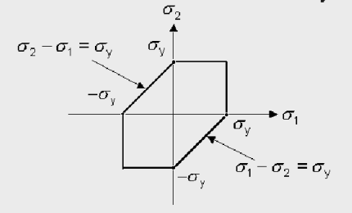
Maximum shear stress theory
In actual design (σ_{et} ) in above equation is replaced by the safe stress. This theory give quite satisfactory results for ductile materials.

Slide 6
Maximum Principal stress theory
This theory also called as Rankine’s theory of failure.
This theory implies that failure will occur when the maximum principal stress (σ₁) in the complex system reaches the value of maximum stress in simple tension at the elastic limit (σ_{et}).Or the minimum principal stress reaches the elastic limit stress (σ_{ec}) in simple compression.

Slide 7
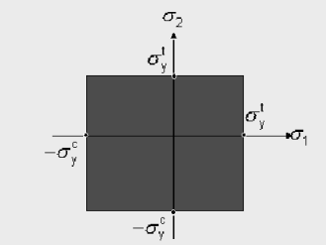
Maximum Principal stress theory
means numerical value of
This theory gives suitable results for brittle materials.

Slide 8
Maximum Normal strain theory
This theory also called as Saint Venant’s theory of failure.
According to this theory failure will occurs when the maximum principal tensile strain (e₁) reaches the value of maximum strain at the elastic limit in simple tension or the minimum principal strains (e₃) reaches the value of maximum stress at the elastic limit in simple compression.
e1 = 1/E [σ1 - µ (σ2+ σ3 )]
e3 = 1/E [σ3 - µ (σ1+ σ2 )]

Slide 9
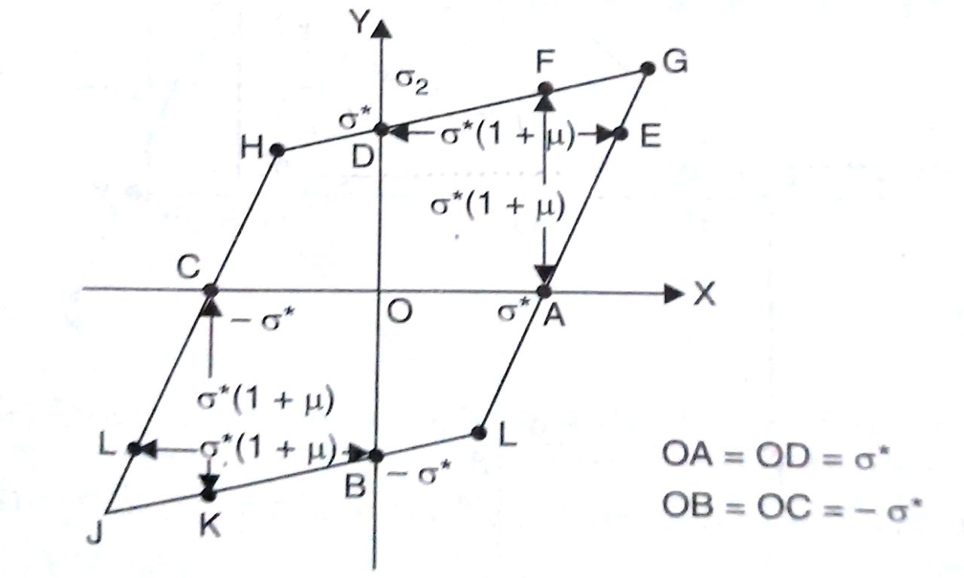
Maximum Normal strain theory
Conditions to failure
e1≥ σet/E ,in simple tension
e3≥ σec/E ,in simple compression
[σ1 - µ (σ2+ σ3 )] ≥ σet
[σ3 - µ (σ1+ σ2 )] ≥ σec

Slide 10
Maximum Shear strain theory
According to this theory failure of a material occurs when the shear stain energy per unit volume in the stresses material reaches a value equal to the shear stain energy per unit volume of the material at the elastic limit. in simple tension.
1/12C [ (σ1 - σ2 ) ² + ( σ2 - σ3 ) ² + (σ3 - σ1 ) ² ]} ≥
2σet ² /12C

Slide 11
Maximum Shear strain theory
This theory also called as Distortion or Von mises – Hencky theory of failure.
(σ1 - σ2 ) ² + ( σ2 - σ3 ) ² + (σ3 - σ1 ) ² ≥ σet ²
For two dimensional
σ2 =0
{σ1 ² + σ3 ² - [ (σ3 σ1 ) ]} ≥ σet ²

Slide 12
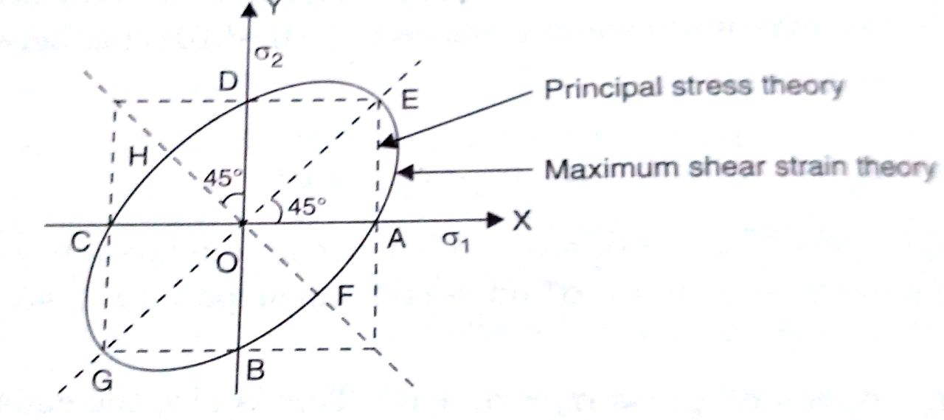
Maximum Shear strain theory

Slide 13
Maximum strain Energy theory
According to this theory failure of a material occurs when the total stain energy in the material reaches the total stain energy of the material at the elastic limit in simple tension
1/2E {σ1 ² + σ2 ² + σ3 ² - 2 µ[ (σ1 σ2 ) ( σ2 σ3 ) (σ3 σ1 ) ]} ≥
σet ² / 2E
{σ1 ² + σ2 ² + σ3 ² - 2 µ[ (σ1 σ2 ) ( σ2 σ3 ) (σ3 σ1 ) ]} ≥ σet²
For two dimensional
σ2 =0
{σ1 ² + σ3 ² - 2 µ[ (σ3 σ1 ) ]} ≥ σet ²

Slide 14
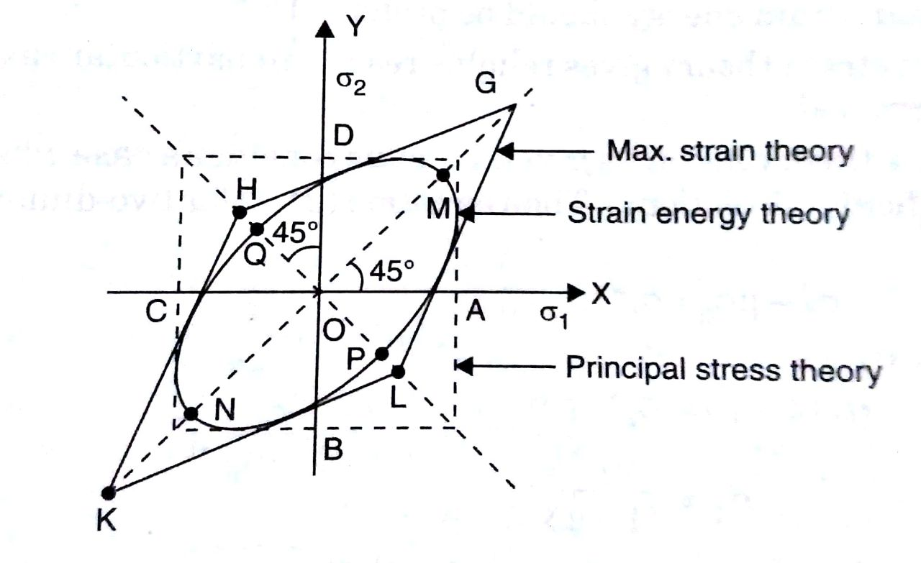
Maximum strain Energy theory

Slide 15
References
Strength of Materials by R. K. Rajput
Strength of Materials L. Singer
Advanced Strength of Materials by Alok Gupta

Slide 16
Thank You

