Slide 1

Machine Design – 1
This Presentation is created by Prof. Shubhrata Nagpal, Professor, Mechanical Engineering Department, Bhilai Institute of Technology,Durg, as a part of OER Activity during the course “Pedagogy for online and Blended Teaching-Learning Process - FDP 201x “ by IIT Bombay X

Slide 2
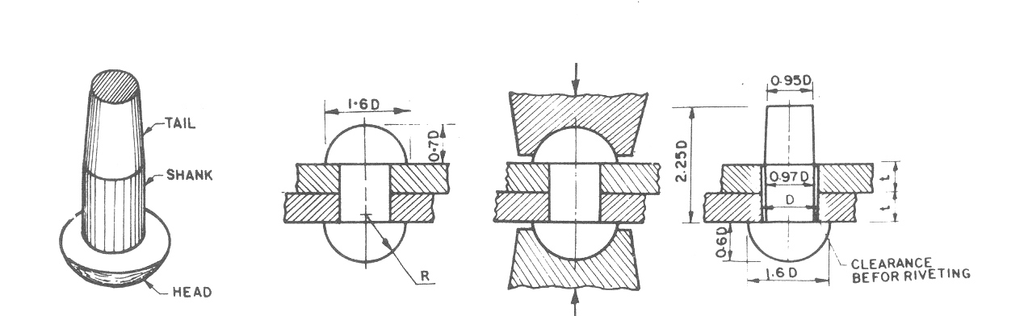
Rivet
A rivet is a ductile metal pin that is inserted through holes in two or more parts and having the ends formed over to securely hold the parts.
Structural work of buildings and bridges
Aerospace equipment etc.

Slide 3
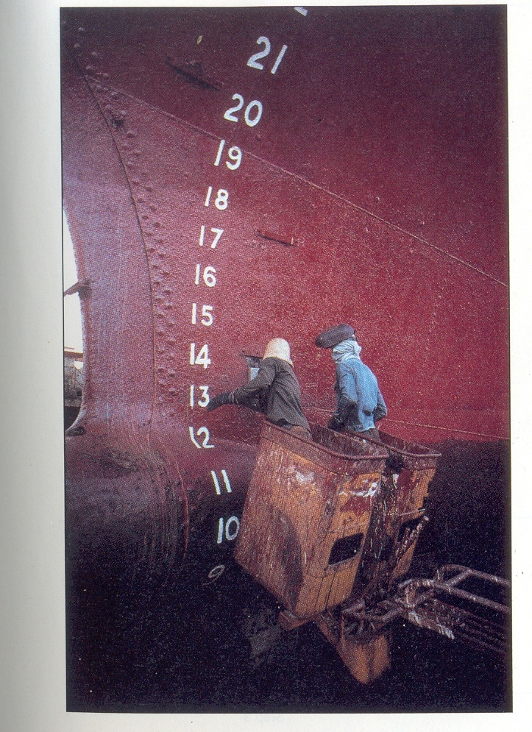

Slide 4
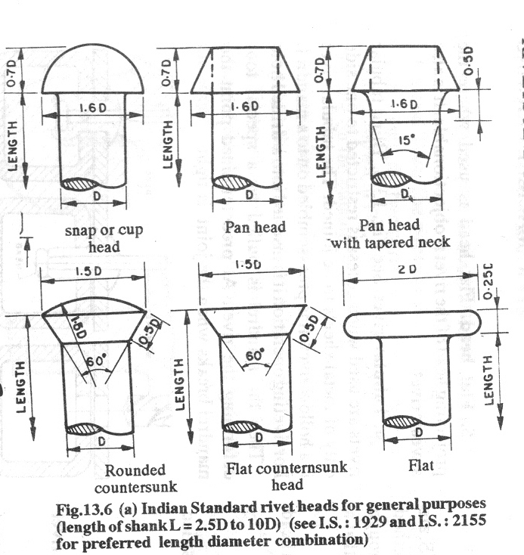
Types of rivets
Indian Standard rivet heads for general purposes (length of shank L = 2.5D to 10 D), IS: 1929, 2155.

Slide 5
Riveted Joints

Slide 6
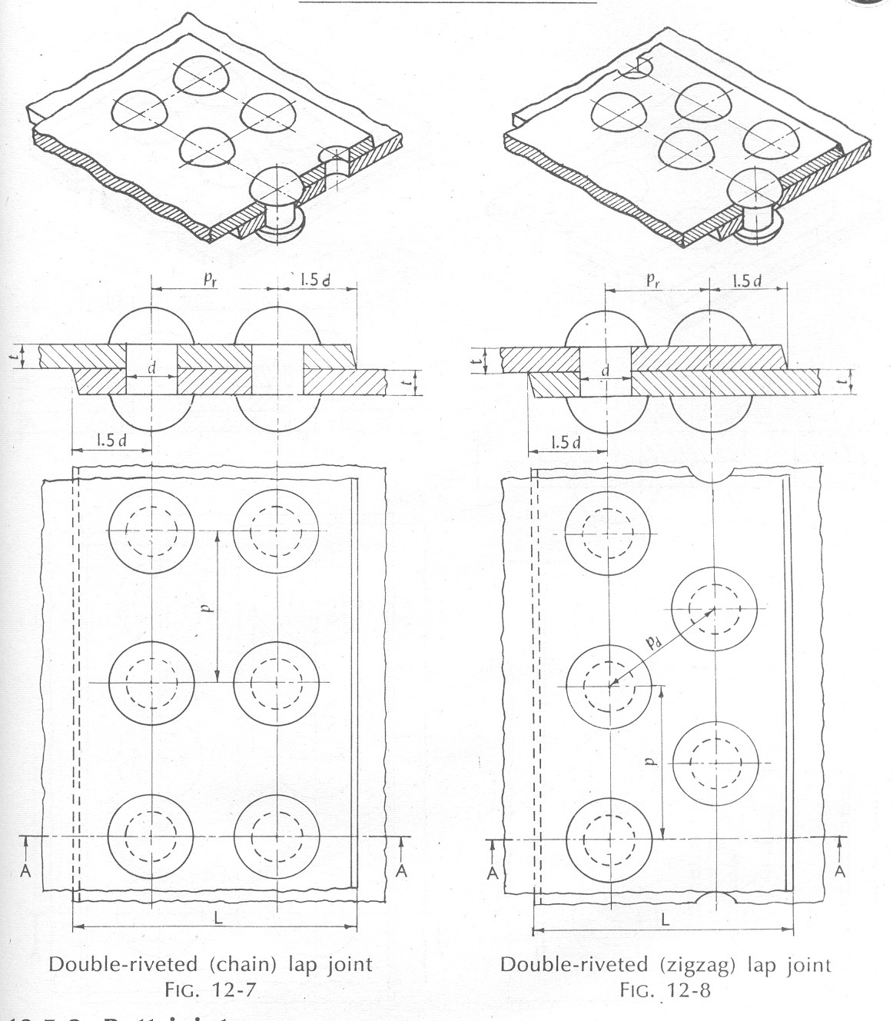

Slide 7
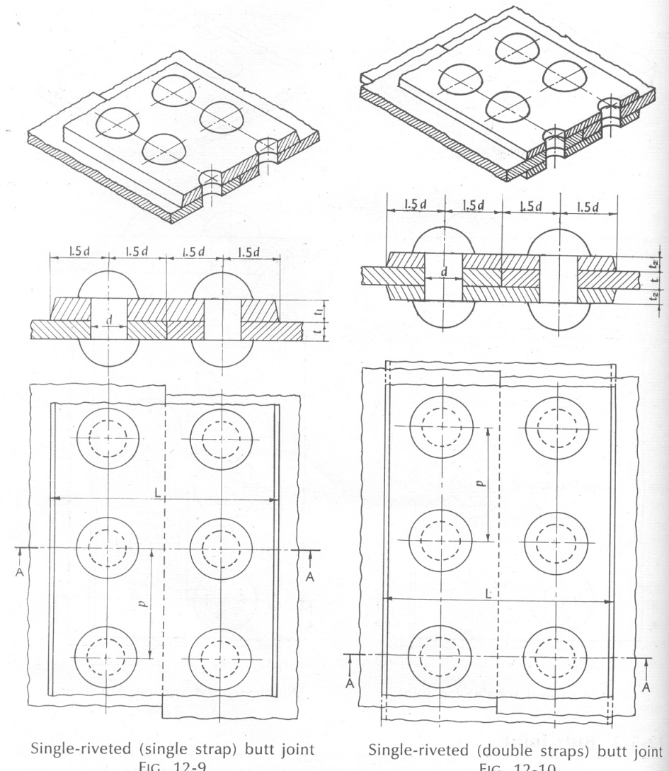

Slide 8
Types of Riveted Joint
Lap joints
main plate
Butt joints
cover plate

Slide 9
Repeating group
Boiler joints (pressure joints)
Repeating group
outer cover plate
Inner cover plate
Structural joints

Slide 10
Multiple rows

Slide 11
Long pitch
Intermediate pitch
Back pitch
Short pitch
Diagonal pitch

Slide 12
Efficiency:
Compares the strength of the joint with that of solids plates
P₀
P₀
Efficiency = P₁/P₀
P₁
P₁

Slide 13
Strength of a Simple Lap joint
(1) Shearing (at connector)
τ
σ_{t}
(2) Tearing (of plate)

Slide 14
(3) Bearing/crushing (of plate)
σ_{c}
(4) Tearing from edges
Unlikely to occur if the distance from the edge of the plate to the connector is large enough (1.75-2 times the diameter of the connector).

Slide 15
(1) Preliminary calculation:
load that can transmitted by one rivet (shear or bearing)
(2) Possible method of failure

Slide 17
d = 20.5 mm

Slide 18
Row 1 (has 1-rivet)
single shear
P-19.8 kN
main plate
cover plate
19.8 kN
19.8 kN

Slide 19
Row 1 (has 1-rivet)
main plate
crush in the main plate
P
37.3 kN
P-37.3 kN
cover plate
37.3 kN
37.3 kN
crush in the cover plate
main plate
P
26.7 kN
P-26.7 kN
cover plate
26.7 kN
Hence strength of row-1 is 19.8 kN
26.7 kN

Slide 20
Row 2 (has 2-rivets)
double shear
39.6 kN
2 x 19.8 kN
Shear strength at row-2 is
2 x 19.8 kN
P-99 kN
2 x 19.8 kN
19.8 kN
19.8 kN
2 x 19.8 kN
59.4 kN

Slide 21
Row 2 (has 2-rivets)
crushing at main plate
37.3 kN
One possible bearing strength at row-2 is
37.3 kN
2 x 37.3 kN
P-94.4 kN
19.8 kN
37.3 kN
57.1 kN
One possible bearing strength at row-2 is
crushing at cover plate
53.4 kN
2 x 26.7 kN
4 x 26.7 kN
P-126.6 kN
Hence strength of row 2 is
74.6 kN
19.8 kN
2 x 26.7 kN
73.2 kN

Slide 22
Row 3 (has 2-rivets)
double shear
2 x 19.8 kN
2 x 19.8 kN
crushing at main plate
crushing at cover plate
Hence strength of row 3 is also
74.6 kN
37.3 kN
2 x 26.7 kN
2 x 37.3 kN
4 x 26.7 kN
37.3 kN
2 x 26.7 kN

Slide 23
Total rivet capacity
74.6 kN
74.6 kN
19.8 kN

Slide 24
Tearing at row 1 of main plate
Tearing at row 2 of main plate

Slide 25
Tearing capacity of main plate
Row 1
Row 2
Row 3
19.8 kN
74.6 kN
74.6 kN
main plate
main plate
19.8 kN
main plate
37.3 kN
37.3 kN
19.8 kN

Slide 26
Tearing capacity of cover plate
Row 1
Row 2
Row 3
19.8 kN

Slide 27
Row 1
Row 2
Row 3
19.8 kN
outer cover plate
9.9 kN
19.8 kN
79.2 kN
19.8 kN
19.8 kN
9.9 kN
inner cover plate

Slide 28
Rivets failure: 169.0 kN
Tearing of main plate: 175.5 kN
Tearing of cover plate: 190.4 kN

Slide 29
Lab joints
Butt joints

Slide 30
shearing capacity of 1-rivet
bearing capacity of 1-rivet
Row1
upper plate
Total rivets capacity

Slide 31
Hence the joint capacity is
Efficiency =
Row2
upper plate
26.94 kN
Row3
26.94 kN
26.94 kN
26.94 kN

Slide 37
References:
Design of Machine Elements by V. B. Bhandari
A Textbook on Machine Design by R.S. Khurmi and J. K Gupta
A Standard Handbook of Machine Design by J. E. Shigley
PSG DESIGN DATA BOOK

